Slide 1
Gender Budgeting 101:
Why Greater Equality Pays Off and Why It’s So Hard to Do
Armine Yalnizyan
Economist and Atkinson Fellow on the Future of Workers
twitter@ArmineYalnizyan #ParlAmericasGender
May 22, 2018

Slide 2

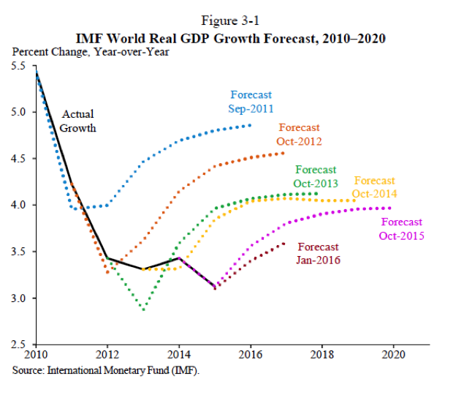
The New Abnormal: “Slowth”
#ParlAmericasGender
Notes:
Chart from Chapter 3 of the Economic Report of the President [of the United States], February 2016. https://www.govinfo.gov/content/pkg/ERP-2016/pdf/ERP-2016.pdf
Initially coined by Stephen Poloz, Governor of the Bank of Canada, Carney used the phrase “serial disappointment” to describe the slowing pace of G20 growth http://www.bankofengland.co.uk/publications/Documents/speeches/2016/speech885.pdf
http://www.cnbc.com/2016/02/26/bank-of-englands-mark-carney-says-lack-of-structural-reforms-to-blame-for-weak-growth.html

Slide 3
Causes of Slowth
Population Aging
Geopolitical Uncertainty
Income Inequality
Climate Chaos
#ParlAmericasGender

Slide 4
Types of Climate Action
Offset trends
Mitigate damage
Improve speed of adaptation
Gender Responsive Budgeting (GRB) facilitates all three strategies
#ParlAmericasGender

Slide 5
Intersection of Climate Action and Gender Budgeting
Energy
Water
Health Care
Housing
Transit
Improved Public Infrastructure Is a Women’s Issue
Pivot from “dirty” to clean energy sources (reduces carbon emissions)
Improve access to clean water, energy, etc (frees up paid/unpaid productive time)
Prevent preventable disease/death
Reduce volatility in individual lives, economy-wide growth
#ParlAmericasGender

Slide 6
The Big Picture
Improve access to basic infrastructure, change the trajectory of women’s lives
Change the trajectory of women’s lives, improve social and economic outcomes
#ParlAmericasGender

Slide 7
Beyond Climate Action:
Why Practice Gender Budgeting?
Economic optimization
  Growth from better resource allocation (L, K, tech)
Social efficiencies
  Better use of paid and unpaid labour, lower risk by broadening access to basics
Fiscal improvements
  Higher revenues, lower costs, less inequitable results
Greater Political Accountability
  Ex ante target setting, ex post review, better data
#ParlAmericasGender

Slide 8
Who Practices Gender Budgeting?
OECD 2016 survey: 12 nations (plus 1)
  Austria, Belgium, Finland, Iceland, Israel, Japan, Korea, Mexico, Netherlands, Norway, Spain, Sweden….since 2017 Canada
IMF survey: 23 nations, mostly non-OECD
  Australia, India, Philippines, Bangladesh, Rep. of Korea, Albania, Macedonia, Ukraine, Morocco, Afghanistan, Timor, Leste, Rwanda, Uganda, Mexico, Ecuador, Bolivia, El Salvador
#ParlAmericasGender
Notes:
OECD 2016 survey: https://www.oecd.org/gender/Gender-Budgeting-in-OECD-countries.pdf The 12 who do have it in this survey have “enshrined the principles of equality”
Non OECD from Janet Stotsky IMF presentation at Rotman School of Management, Institute for Gender and the Economy, University of Toronto, Workshop on Gender Budgeting April 4, 2017 https://www.dropbox.com/sh/0582di3vn72n9rq/AAACLgbGAJuXkuc-w3LwSelJa?dl=0&preview=janet+stotsky-Presentation+on+gender+budgeting+++for+Toronto+workshop.pdf

Slide 9
How To Do Gender Budgeting?
Ex Ante
Establish baseline: who gets what?
Needs assessment: what’s missing in the status quo?
Develop strategy: targets/timelines, resources
Indicators to change
  Rates of violence against women
  Access to Utilities (water, fuel/energy, telcom)
  Health/education outcomes
  % Budget on Housing, Child Care, Education, tax exps
  Labour Force Participation Rates; Wage Gap
  Expand Social Security (% with pensions, jobless benefits)
#ParlAmericasGender

Slide 10
How To Do Gender Budgeting?
Ex Post
Course correct budgetary resource allocations to achieve performance goals
Review and assess incidence of budgetary measures (tax and spend)
Within Finance, outside of Finance (government/opposition); gender audit
Separate gendered analysis/documents or built into budget (review outcomes from previous budgets; progress on targets/timelines)
#ParlAmericasGender

Slide 11
How To Talk About Budgets
Costs vs Benefits of Federal Spending
Women use *and* provide more public services
BUT
It’s easier to calculate costs of spending than benefits
Focus on taxes/tax cuts is about who pays (“winners and losers”) disconnected from what is being paid for
It’s harder to measure both benefits of services provision and impacts of service loss (what is relevant time frame; distribution of impacts by age, gender, incomes; direct/indirect benefits)
#ParlAmericasGender
Notes:
Attempts in Canada to measure benefits: Gillespie (1964, 1980); Dodge (1975); Vermaeten (1997); CCPA (2009)

Slide 12
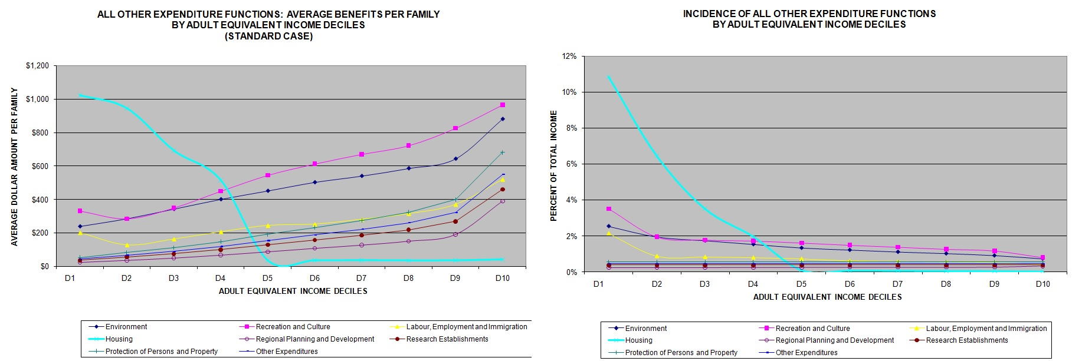
Who Benefits From Spending? More Low Income Households (Women)
Vermaeten: Fed spending on housing in 1994 was highly redistributive, measured by $ or by % of income
#ParlAmericasGender
Notes:
Unpublished documents. Available on request.

Slide 13
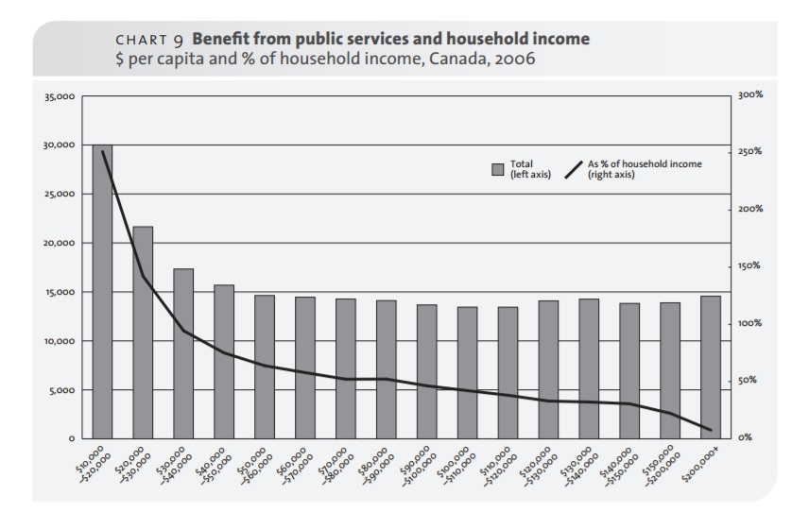
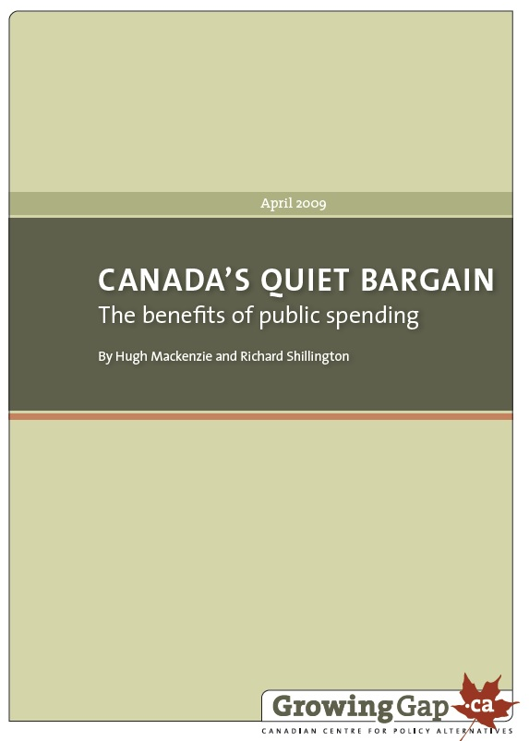
Who Benefits From Spending? More Low Income Households (Women)
CCPA: Government services in 2006 were worth over two times as much as the incomes of the poorest Canadian households
#ParlAmericasGender
Notes:
https://www.policyalternatives.ca/publications/reports/canadas-quiet-bargain

Slide 14
Who Benefits From Tax Cuts?
More High Income Individuals (Men)
Policy priority in past 25 years: “More Money In Your Pockets”
Who Do Tax Cuts Reach?
As of 2017 final tax statistics (2015 incomes)
  27.0% of men did not have taxable income
  37.4% of women did not have taxable income
Since 2008, data on income class plus gender no longer published
Who Do Services Reach?
From what we know by age, gender and income, typically women are more reliant on public services
Long-form Census is one source of data
Administrative data (ex. health care, education, social housing)
Only Census provides race, immigration status data
#ParlAmericasGender
Notes:
Source: Canada Revenue Agency Tax Statistics https://www.canada.ca/en/revenue-agency/programs/about-canada-revenue-agency-cra/income-statistics-gst-hst-statistics/t1-final-statistics.html

Slide 15
GRB offers a radically different approach to budgeting
Current Focus: on costs
GRB Focus: on benefits
Focus on budget balance/deficits
ACCOUNTING FRAMEWORK
Irony: measures that “save” money end up costing more (health care, prisons, police, justice)
Focus on improving benchmarks associated with greater well-being
HEALTH/QoL FRAMEWORK
Irony: measures that require more “spending” can end up saving more (less health care, jobless benefits, prisons, etc.)
You reap what you sow
#ParlAmericasGender

Slide 16
GRB offers transformative outcomes from budgeting
System-based, not departmental
Outcome-oriented, not spending. The focus is on monitoring performance to achieve targets
Links costs to benefits
Like population health interventions: improves system “health” by reducing inequities
Like population health research: we’re in the early stages of learning how to improve measures of benefits/outcomes (fiscal year? 5 years? Lifecycle?)
#ParlAmericasGender

Slide 17
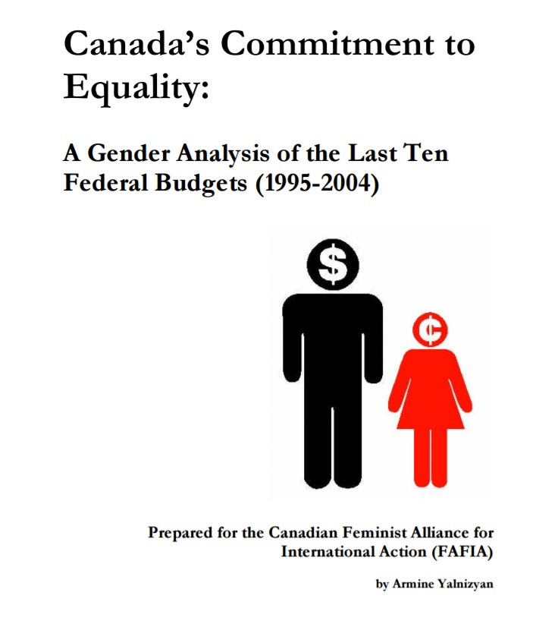
What Do You Need To Do GRB?
Ability to track past program spending
  Public Accounts, Tax Expenditures
Ability to model costs/benefits of future proposals
Access to Data
Interest of government/opposition
Resources: no $, no strategy
#ParlAmericasGender
Notes:
https://www.policyalternatives.ca/publications/reports/canada%E2%80%99s-commitment-equality

Slide 18
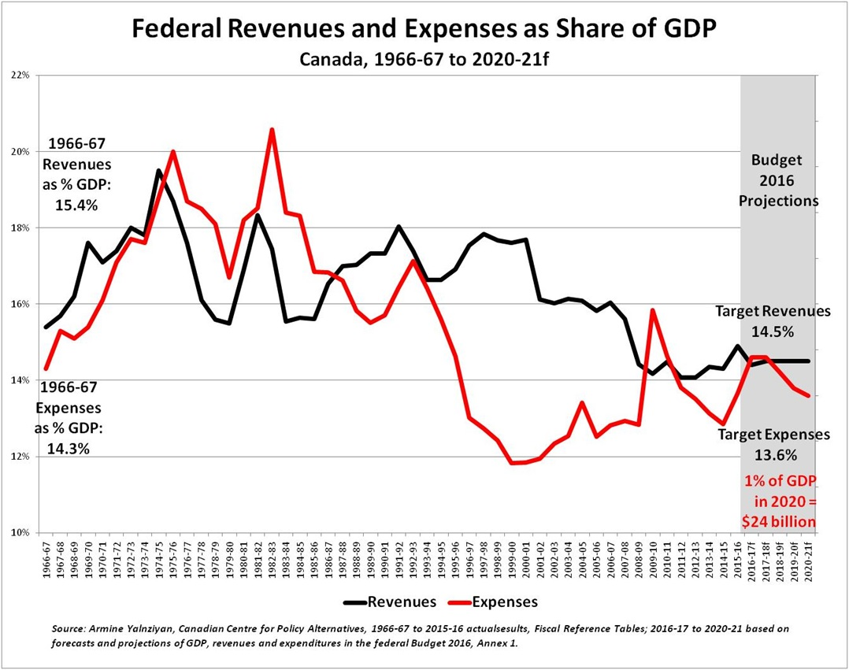
How Much $ Buys Change? Size Matters, but...
“It’s not how big it is; it’s how you use it”
#ParlAmericasGender

Slide 19
Gender Budgeting 101 Takeaways
Within context of slowth and increasingly fractious politics, distributional considerations in budgets matter more than ever
Budget measures that tackle gender inequality are rapidly becoming more politically acceptable/popular
Gender budgeting can improve economic performance, political accountability, and social outcomes
Such results are unlikely to occur without more public spending, but how you spend is as important as how much you spend
#ParlAmericasGender

Slide 20

Thank you for your time and your commitment to change
#ParlAmericasGender

