Slide 1
Gender Equality, the SDGs and Small Islands Developing States

Slide 2
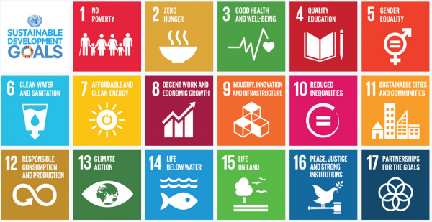
The SDGs

Slide 3
TARGETS
Goal 5 includes 9 key targets, 6 substantive and 3 on means of implementation. Strong focus on transformative change.
5.1 gives substance to CEDAW through a key indicator on ending all forms of discrimination against women and girls.
5.2 and 5.3 deal with serious violations of women’s and girl’s rights – all forms of violence including trafficking and sexual and other types of exploitation; child, early and forced marriage, and FGM.
5.4 introduces for the first time a focus on recognition of unpaid care work.
5.5 and 5.6 deal with realization of right to full and effective participation in decision-making, and universal access to SRHRR – in line with Cairo and BPfA.
Means of Implementation targets include women’s equal right to economic resources; access to ICT; and an enabling legislative and policy environment for gender equality and women’s empowerment

Slide 4
TARGETS
Key gender sensitive targets included under other Goals. For example:
Goal 1 (Poverty): Target 1.4 Equal rights to economic resources, access to basic services, ownership and control over land and other forms of property, inheritance, natural resources, new technology, micro-finance
Goal 3 (Health): Target 3.1 reduce global maternal mortality ratio to less than 70 per 100,000 live births; Target 3.7 ensure universal access to SRH services and integration of reproductive health into national strategies and programmes;
Goal 4 (Education): Target 4.5 eliminate gender disparities in education and ensure equal access to all levels of education and vocational training…
Goal 8 (Growth and Decent Work): Target 8.5 By 2030, achieve full and productive employment and decent work for all women and men…
Goal 11 (Cities and Human Settlements): Target 11.7 by 2030 provide universal access to safe, inclusive, accessible, green and public spaces in particular for women and children, older persons and persons with disabilities
Goal 16 (Peaceful and Inclusive Societies): Target 16.1 Significantly reduce all forms of violence and related deaths everywhere.

Slide 5
TARGETS
Recognition that many ‘environmental’ goals have a gender dimension, with focus on women’s access to land, water, sanitation and energy in related targets.
Means of Implementation
In addition to the three specific targets under Goal 5, other relevant MOI targets, e.g.
Target 1.b – gender sensitive development strategies;
Target 4.a education facilities that are child, disability and gender sensitive – and safe, non-violent and inclusive.
Target 16.b – non-discriminatory laws and policies for sustainability.
Target 17.18 – disaggregation of data by “income, gender, age, race, ethnicity, migratory status, disability, geographic location and other characteristics relevant in national contexts”

Slide 6
SDGs | SAMOA Pathway
Goal 1 End poverty in all its forms everywhere | Preamble (paragraph 6) Sustained and Sustainable Econ Growth (paras 23-27) Social Development paragraph 79
Goal 2 End hunger, achieve food security and improved nutrition and promote sustainable agriculture | Food security and nutrition paragraph 59 to 63
Goal 3 Ensure healthy lives and promote well-being for all at all stages | Health and non-communicable diseases paragraph 72 to 75

Slide 7
SDGs | SAMOA Pathway
Goal 4 Inclusive and equitable quality education | Social Development - education paragraph 87, 88
Goal 5 Gender equality and empower all women and girls | Gender equality and women’s empowerment paragraph 76, 77
Goal 6 Water and sanitation for all | Water and sanitation paragraph 64, 65
Goal 7 Access to affordable, reliable, sustainable and modern energy | Sustainable Energy paragraph 47 to 50
Goal 8 Promote sustained, sustainable economic growth, | Sustained and sustainable, inclusive and equitable economic growth with decent work for all paragraph 23 to 30

Slide 8
SDGs | SAMOA Pathway
Goal 9 Infrastructure and industrialization | Sustained and sustainable, inclusive and equitable economic growth with decent work for all paragraph 27.c
Goal 10 Reduce inequality within and among countries | Preamble paragraph 7 Gender equality and women’s empowerment paragraph 77 h
Goal 11 Make cities and human settlements inclusive, safe, resilient and sustainable | Disaster risk reduction paragraph 51 Sustainable transportation paragraph 66, 67 Management of chemicals and waste, including hazardous waste paragraph 70
Goal 12 Ensure sustainable consumption and production patterns | Water and sanitation paragraph 65 Sustainable consumption and production paragraph 68, 69
Goal 13 Take urgent action to combat climate change and its impacts | Climate change paragraph 31 to 46

Slide 9
SDGs | SAMOA Pathway
Goal 14 Conserve and sustainably use oceans, seas | Oceans and seas paragraph 53 to 58
Goal 15 Protect, restore and promote sustainable use of terrestrial ecosystems, | Biodiversity paragraph 89 to 94 Invasive alien species paragraph 95
Goal 16 Promote peaceful and inclusive societies | Social Development – promoting peaceful societies and safe communities paragraph 83 to 86
Goal 17 Strengthen the means of implementation | Means of implementation, including partnerships paragraph 96 to 120

Slide 10
